Slide 1
Bandwidth
Bandwidth is defined as a range within a band of frequencies or wavelengths. Bandwidth is also the amount of data that can be transmitted in a fixed amount of time.
For digital devices, the bandwidth is usually expressed in bits per second(bps) or bytes per second. For analog devices, the bandwidth is expressed in cycles per second, or Hertz (Hz).
The bandwidth is particularly important for I/O devices. For example, a fast disk drive can be hampered by a bus with a low bandwidth.

Slide 2
Network bandwidth is the capacity of a wired or wireless network communications link to transmit the maximum amount of data from one point to another over a computer network or internet connection in a given amount of time -- usually, one second. Synonymous with capacity, bandwidth describes the data transfer rate. Bandwidth is not a measure of network speed -- a common misconception.
How bandwidth works
The more bandwidth a data connection has, the more data it can send and receive at one time. Bandwidth can be compared to the amount of water that can flow through a water pipe. The bigger the pipe, the more water can flow through it at one time.

Slide 3
Bandwidth works on the same principle. So, the higher the capacity of the communication link, or pipe, the more data can flow through it per second.
End users pay for the capacity of their network connections. Therefore, the greater the capacity of the link, the more expensive it is.
Bandwidth vs. speed
The terms bandwidth and speed are often used interchangeably – but not correctly. The cause of the confusion may be due, in part, to their use in advertisements by internet service providers (ISPs) that refer to greater speeds when they actually mean bandwidth. Essentially, speed refers to the rate at which data can be sent, while the definition of bandwidth is the capacity for that speed. To use the common water metaphor, speed refers to how quickly water is flowing through a pipe; bandwidth refers to the diameter of the pipe. In order to avoid confusion, it makes more sense to use the terms bandwidth (or bandwidth capacity) and network speed, rather than bandwidth speed.

Slide 4
How to measure bandwidth
While bandwidth is traditionally expressed in bits per second (bps), modern network links have greater capacity, which is typically measured in millions of bits per second (megabits per second, or Mbps) or billions of bits per second (gigabits per second, or Gbps).
Bandwidth connections can be symmetrical, which means the data capacity is the same in both directions to upload or download data, or asymmetrical, which means download and upload capacity are not equal. In asymmetrical connections, upload capacity is typically smaller than download capacity.

Slide 5
Bit rate and Baud rate
The baud rate is the rate at which information is transferred in a communication channel. Baud rate is commonly used when discussing electronics that use serial communication. In the serial port context, "9600 baud" means that the serial port is capable of transferring a maximum of 9600 bits per second.

Slide 6
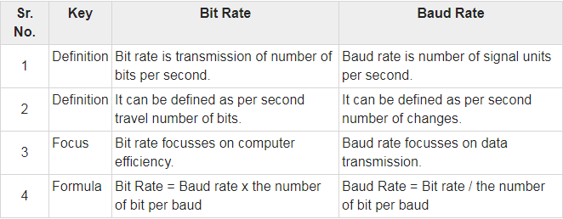
Both Bit rate and Baud rate are used in data communication. Bit rate and Baud rate are related using below formula.
Bit Rate = Baud rate x the number of bit per baud

Slide 7
